Slide 1



Day 24
contact@anubhavtrainings.com
ABAP RESTFUL APPLICATION PROGRAMMING

Slide 2

Agenda – Day 24
What is RAP (Restful Application Programming Model)
The big picture
Evolution – The developer view
The development flow
Types of Scenarios
Understanding Data Model
Types of Scenarios
Managed Scenario
Unmanaged Scenario
Flow of Development (Unmanaged Scenario)
Defining CDS Views
Creating OData Service ( Business Service)

Slide 3

Restful ABAP Programming
The ABAP RESTful programming model defines the architecture for efficient end-to-end development of intrinsically SAP HANA-optimized OData services (such as Fiori apps) in SAP Business Technology Platform ABAP Environment. It supports the development of all types of Fiori applications as well as A2X services. It is based on technologies and frameworks such as Core Data Services (CDS) for defining semantically rich data models and a service model infrastructure for creating OData services with bindings to an OData protocol and ABAP-based application services for custom logic and SAPUI5-based user interfaces .
The whole architecture is based on
CDS views – will helps you to create semantically rich data model
Business Object – here is a node inside a tree data structure which is achieved by using root keyword at CDS view level, this is needed only if we want to add transactional capability.
Finally create a service using service definition and service binding
The binding will confirm the Purpose of service – API or Fiori
UI layer with the Fiori app using elements

Slide 4
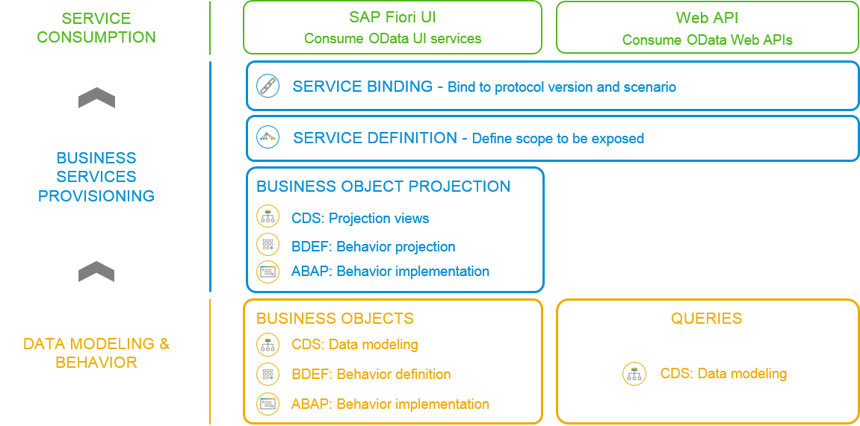
Flow of RESTful Application Programming

Slide 5
Important Tables
CDS Views on these table for ease of access
Database tables
Represents entire aviation tourism
/DMO/CARRIER– Contains all the airline codes
I_Currency
CDS view to access currency codes
/DMO/AGENCY
Agent information website/person who helps
/DMO/CONNECTION– FLIGHT infor from origin to destination
I_Country
Country codes
/DMO/TRAVEL
Trip information
/dmo/flight– given flight for diff. dates
/DMO/CUSTOMER
Customer data who willing to book flights
/DMO/BOOKING
Connecting flights in whole travel

Slide 6
Types of Scenario
Brownfield Implementation
Is used when we want to create a transactional application which can insert, update, delete data from the system by writing your own logic
You already have Business logic with you and you want to use that business logic to perform transactional capability
You are own your own to manage your implementation.
02. Managed Scenario
Greenfield Implementation
Is used when we want to create a transactional application which can insert, update, delete data from the system by using the framework provided implementation
You do not have Business logic with you and you want system to create business logic for you automatically.
01. Un-Managed Scenario

Slide 7
Flow of Development (Unmanaged Scenario)
Fiori UI
Service Binding for UI
Service Definition
Travel – Using /demo/travel
Projection view- what we want to show to UI
1
N
I_Currency
1
N
N
Agency
Customers
I_Country

Slide 8
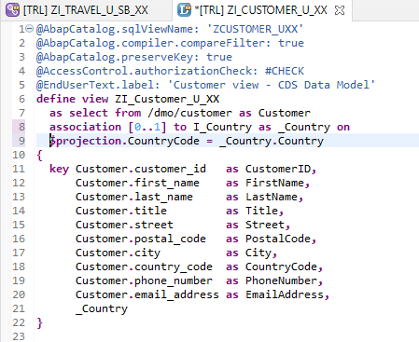
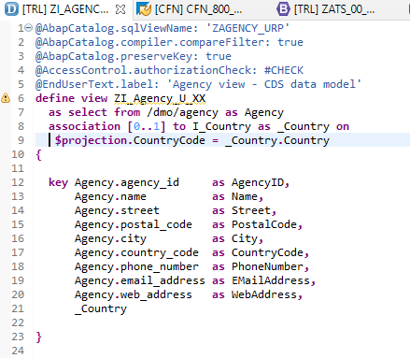
Defining Data Models
Create Customer CDS View “ZI_Customer_U_XX”
Create Customer CDS View “ZI_Agency_U_XX”

Slide 9
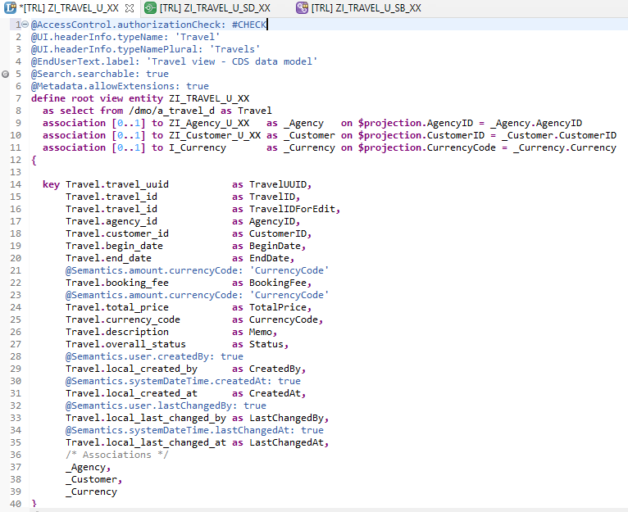
Root CDS Entity
On top of Customer and Agency CDS View we Create Root CDS View EntIty called “ZI_TRAVEL_U_XX”.
With Annotations like Metadata ,Search ,
Semantic Annotation etc.
Association to Agency ,Customer , Currency.

Slide 10
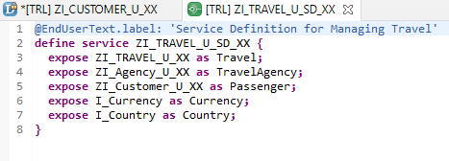
Create OData Service ( Business Service )
A business service definition (short form: service definition) describes which CDS entities of a data model are to be exposed so that a specific business service, for example, Sales Order handling, can be enabled. It is an ABAP Repository object that describes the consumer-specific but protocol-agnostic perspective on a data model. “ZI_TRAVEL_U_SD_XX”
CDS Entity
Service Definition
Service Binding

Slide 11
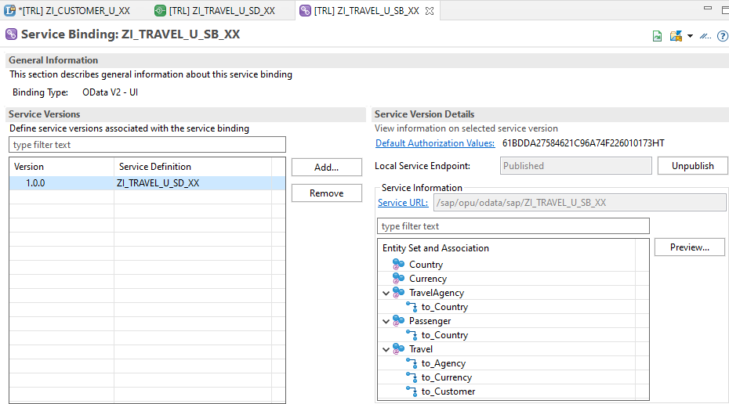
Service Binding ( Business Service )
The business service binding (short form: service binding) is an ABAP Repository object used to bind a service definition to a client-server communication protocol such as OData. Like any other repository object, the service binding uses the proven infrastructure of the ABAP Workbench, including the transport functionality.

Slide 12

End of Day 24
Trainer: Anubhav Oberoy

Slide 13

Trainer: Anubhav Oberoy

Slide 14
THANK YOU
If you cannot do
great things, do small things in a great way.
Anubhav Oberoy
https://www.anubhavtrainings.com

Slide 15


We’re committed to empower you to be
Most Desirable Resource
through powerful training solutions.
We build the workforce of the future.
250+
Corporate Clients
30,000+
Learners Trained
25000+
Learners Placed
FREE WEBINARS
Sign up for free webinars with industry experts every fortnight!
Enroll Now!
Contact us today!
https://anubhavtrainings.com/

Slide 16




More from AnubhavTrainings.com

